Slide 1
Level II: Depression Awareness
One-Day Lesson
To edit/customize this slideshow, please make a copy.

Slide 2
You will...
Define that depression is a mood disorder
Describe the signs & symptoms of depression
Identify a reliable, trusted adult at school and/or in the community
Discuss how to maintain good mental health

Slide 3
Erika's Lighthouse Overview
This program was inspired by a young person named Erika. Erika was a bright light who, sadly, lost her battle with depression in 2004, at age 14.
Erika's Lighthouse was founded in her honor and is dedicated to helping other young people learn about depression and overcome the stigma surrounding mental health disorders.

Slide 4
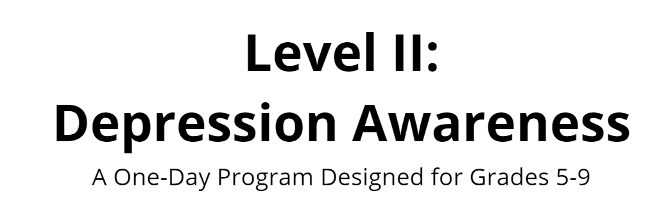
The Video

Slide 5
Discussion
What are the symptoms of depression?
Give an example of what that could look like in a teen.

Slide 6
Symptoms
Depressed mood, sadness or irritability
Loss of interest or pleasure in activities
Change in weight or appetite
Change in sleep
5 symptoms present
most of every day
for at least 2 weeks
Feeling sped up or slowed down
Fatigue or loss of energy
Feelings of worthlessness or guilt
Trouble concentrating or making decisions
Thoughts of death or acts of self-harm

Slide 7
If you are worried about yourself or a friend, you should always talk to a
Trusted Adult
When I say the words TRUSTED ADULT, what characteristics or traits come to mind?

Slide 8
You can get help for yourself or a friend by saying something
How to talk to a trusted adult
How to talk to a friend in need

Slide 9
Role Play

Slide 10
Hey Mom,
Can we talk?

Slide 11
YOU:
Hey, Mom, can we talk?
MOM:
Sure. What's going on?
YOU:
Lately, I haven't been feeling like myself. I feel sad and angry all the time. I'm constantly tired, and I can't focus in school.
MOM:
I've gone through periods like this when I was your age. Hang in there and I'm sure things will get better with a little time.
YOU:
Well, usually when I'm down I feel better if I go for a run or talk to someone. This time I can't seem to shake it. It's been like this for a few weeks now. I even took a depression test online and it reported that I should see a doctor to get it checked out.
MOM:
Really?
YOU:
Yeah, I think I need to talk to someone. Can you help me set up an appointment with my doctor?
MOM:
Sure. I think that's a great idea.

Slide 12
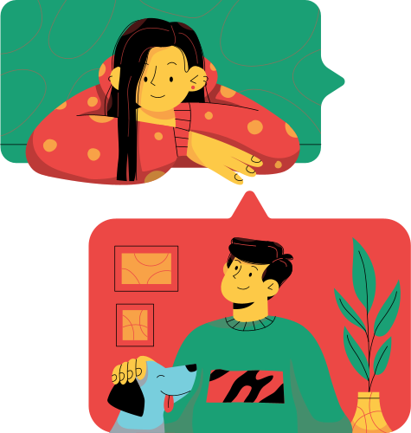
Hey Sam,
Can we talk?

Slide 13
YOU: Hey, can we talk? Over the past few weeks, I’ve noticed you've been hanging back a lot – not calling or texting me much anymore and skipping out on me and our friends. Recently, you have even missed quite a few play practices. In general, you seem down. This isn’t like you. What’s going on?
FRIEND: I’m sorry; I’ve been feeling weird lately.
YOU: I can tell something is different. I’m worried about you and I care.
FRIEND: You don’t have to worry. I’m sure I’ll snap out of it, eventually.
YOU: You deserve to feel better now and, who knows, it could be something serious like depression. Have you told an adult yet?
FRIEND: No.
YOU: An adult should know so they can help you find a professional to check it out. Who do you feel comfortable talking to?
FRIEND: I guess, Mr. Clark.
YOU: I think he’s a great choice. Would you like me to come with you? It might make you more comfortable.
FRIEND: Uh, sure. Yeah, I'd like that

Slide 14
Good Mental Health
Coping Strategies
Good Mental Health Practices

Slide 15
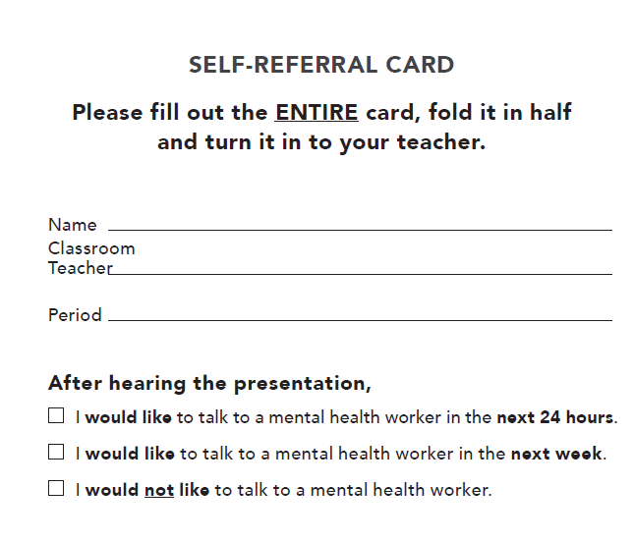
Self-Referral Cards

Slide 16
Whatever time: Day. Night. Weekend.
Whatever the reason: Mental health distress. Thoughts of suicide. Worried about a friend or loved one. Would like emotional support.
The 988 Suicide & Crisis Lifeline is here for you.
Text or Call 988 | Chat 988lifeline.org |
For emergencies, call 911

